Slide 1
Chapter 5: Percentages, Percentiles and Probabilities

Slide 2
The Basics: Raw Scores (1 of 2)
The original, untransformed score.
Norm-referenced scores.
Criterion-referenced scores.
Notes:
Raw score:
It is the observed, original, and untransformed score before any operation is performed on it.
Raw scores by themselves don’t talk much about but form the basis for other scores (percentile ranks and other standard scores) that tell a lot and are very important for interpreting performance.
Raw scores are essentially meaningless.
For example, a student Stu scored a raw score of 18 and Lori got a raw score of 7 on a 20-item test for 50 different people.
The raw scores of 18 and 7 do not say how difficult the questions are, what type of questions were used, whether the test was timed or not, etc.
Norm-referenced scores:
Norm-referenced interpretations give meaning to performance by comparing people to other people by using norms to evaluate one’s relative performance.
For example, a norm-referenced interpretation for Stu, would be “he scored much better than the majority of the other 49 test takers.”
Norm-reference scores compare individual scores to what is normal or typical.
Norms: established to aid in interpretation and are identified through research studies that have been administered to a huge number of people to see what is actually normal in the real-world.
Criterion-referenced scores:
Criterion-referenced interpretations give meaning to performance by comparing people’s scores to some standard or a specific score called the cut score.
The criterion is determined by the experts or theory.

Slide 3
The Basics: Raw Scores (2 of 2)
The significance of norms.
The use of norms in a behavioral disorder test.
Common way to use the norm.
Notes:
The significance of norms:
Norms are valuable for lots of reasons.
The most important is that they allow comparing outcomes with others in the same test-taker group.
The use of norms in a behavioral disorder test:
Consider the example of the Emotional or Behavior Disorder Scale (Revised).
The scale is used in the early identification of students with emotional or behavioral disorders.
4,308 students aged 5 through to 18 years were used as a group to develop the norms.
To know how excessive behavior might be for any one child within that same age range, the child’s score is compared with this set of norms to see how different it is.
Common way to use the norm: The most common way to use norms is to take an individual raw score and convert it into one of several values that are more easily understood by students, parents, and teachers and more easily shared in that they have some universal characteristics.

Slide 4
Percentiles (or Percentile Ranks) (1 of 7)
A common way to understand raw scores.
The percentile rank.
Lower percentile means lower rank.
Percentile vs. percentage.
Notes:
A common way to understand raw scores:
A very common way of understanding individual raw scores is to examine the score relative to the rest of the scores in the set.
For instance, when Stu got a raw score of 18, we need to examine further to understand what that means relative to the other scores in the group.
The percentile rank:
Percentile or percentile rank is a distribution of scores below which a given percentage of scores falls or can be understood as the percentage of people scoring less than a particular raw score.
It’s a particular point within an entire distribution of scores, and there are 100 such percentiles or percentile ranks (in reality there are only 99).
Percentiles are probably the score most often used for reporting test results in schools.
For example, the 45th percentile is the score below which 45% of the other scores fall.
Lower percentile means lower rank:
Percentile says nothing about raw scores. For instance, the 45th percentile could have a raw score of 88 or 22.
But the lower the percentile, the lower the person’s rank in the group.
Percentile vs. percentage: The percentile does not indicate the percentage of questions that someone got right.

Slide 5
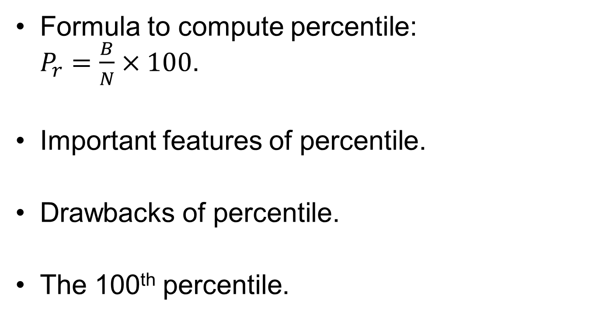
Percentiles (or Percentile Ranks) (2 of 7)
Formula to compute percentile:
$P_{r}=\frac{B}{N}×100$.
Important features of percentile.
Drawbacks of percentile.
The 100th percentile.
Notes:
Formula to compute percentile:
To calculate the percentile for any raw score in a set of scores, use the following formula, $P_{r}=\frac{B}{N}×100,$ where:
P_{r} = the percentiles.
B = the number of observations with lower values.
N = the total number of observations.
Important features of percentile:
Percentiles are easy to compute and understand.
They can be applied across almost any test situation and any kind of test.
Examples: a test of culinary skills or a test of internal locus of control.
Drawbacks of percentile:
Percentile ranks tell very little about qualitative performance.
They are norm-referenced, not criterion-referenced, and it is not always meaningful to interpret performance by comparing it to how other people perform.
Also, the use of percentile ranks assumes that the larger sample from which they came is normally distributed (the curve is bell shaped).
Percentile ranks are not equally spaced on whatever underlying scale is being tested. While this is not a shortcoming, one needs to understand this point while interpreting percentiles.
The 100th percentile:
One may never see a percentile rank of 100 for a score on a test.
The upper limit for a percentile for even the best score on a test is 99 because an individual can be better than others but not better than himself.
But when percentiles are computed as the percentage of people equal to or below a given score, a 100th percentile is possible.
In that case, 0th is not possible.

Slide 6
Percentiles (or Percentile Ranks) (3 of 7)
The median: 50th percentile.
Steps to compute the median.
Computing median with odd number of scores.
Notes:
The median:
It is the special percentile.
It is the 50th percentile, or the point at which 50% of scores fall below and 50% fall above.
It is the midpoint in a distribution of scores and has some special qualities too.
Steps to compute the median:
Step 1: List the values in order, from either highest to lowest or lowest to highest.
Step 2: Find the middle-most score and that’s the median.
Computing the median of scores:
Computing median with odd number of scores.:
Consider five SAT verbal scores ordered from highest to lowest : 740, 560, 550, 490, 480.
Of these five values, 550 is the middle-most value and is therefore the median.

Slide 7
Percentiles (or Percentile Ranks) (4 of 7)
Computing median with even number of scores.
Computing median when middle values are same.
Reason to use median instead of mean.
Notes:
Computing the median of scores:
Computing median with even number of scores:
To the previous example, add another score which is 540.
Now there are six scores and in this case the median is simply the average of the two middle values.
Since average is referred to as mean, median is the mean of the average of the two middle values.
Computing median when middle values are same:
If the middle-most values are the same, then the media is the same as both of those middle-most values.
So, if 550 is added instead of 540, then 550 is the median.
Reason to use median instead of mean:
One very good reason to use median instead of the mean is that median is insensitive to extreme scores, whereas the mean is not.
An extreme score is the one that is very different from the group to which it belongs.
For example, if the scores were 740, 560, 550, 490, 480, then the value 740 is different from the other five than any other value in the set, and we would consider that an extreme score.
The mean of the scores would be 564 but median would be 550.
The value 550 is more representative of the group and lies more in the “middle” of the group.

Slide 8
Percentiles (or Percentile Ranks) (5 of 7)
Quartile: 25th or 75th percentile.
Deciles: a set of 10 adjacent percentile points.
Notes:
Quartile:
It is another special type of percentile.
The 25th percentile is the Q1, or the first quartile, and the 75th percentile is the Q3, or the third quartile.
Quartiles divide the distribution of scores into quarters or fourths.
Deciles:
A set of 10 adjacent percentile points, such as 10–19 or 70–79.
Consider a set of scores and divide it into 10 equal parts. You now have a set of deciles.
The first decile is the first 10 percentile ranks, the second decile is the second set of 10, and so on.

Slide 9
Percentiles (or Percentile Ranks) (6 of 7)
What’s to Love About Percentiles
Easy to use.
Norm-referenced.
Independent of raw scores.
Notes:
Easy to use: Percentiles are easily calculated and easily understood by all parties such as students, teachers, parents, etc.
Norm-referenced:
They are computed based on one’s relative position to others in the group.
Hence, they are norm-referenced.
Independent of raw scores:
You can compare across different areas of performance, because a percentile is a percentile is a percentile.
Also, percentiles are independent of raw scores.

Slide 10
Percentiles (or Percentile Ranks) (7 of 7)
What’s Not to Love About Percentiles
Do not reflect differences accurately.
Give rise to confusion.
Notes:
Do not reflect differences accurately:
Percentile ranks reflect raw scores.
But they do not accurately reflect differences between raw scores and differences between percentiles.
Give rise to confusion: There is often the confusion between percentage and percentile and the difference is not clearly charted.

Slide 11
Stanines (or Stanine Scores)
(1 of 3)
Divide a distribution into nine equal segments.
Bands of percentiles.
Converting raw scores to stanines.
Notes:
Stanines:
Divide a distribution into nine equal segments (1–9).
Each of the nine stanines represents one half of a standard deviation, except for Stanines 1 and 9, which are a bit smaller.
Bands of percentiles:
The stanine is like a percentile but only a band of percentiles under the distribution of scores.
It is a fast and efficient way to report a test score.
Converting raw scores to stanines:
When raw scores are converted to stanines, the nine stanines have a mean of 5 [(1 + 9)/2 = 5] and a standard deviation of 2.
So, if Stu who is in the 82nd percentile will be in the eighth stanine.

Slide 12
Stanines (or Stanine Scores)
(2 of 3)
What’s to Love About Stanines
Easy to compute.
Represent equal units.
Raw score equivalents for stanines are not disproportionate.
Notes:
5.3. Identify and interpret stanines.
What’s to Love About Stanines
Easy to compute:
Stanines are easy to compute.
Since they can be represented as a single digit, they can communicate lots of information easily and effectively.
Represent equal units:
They represent equal units along the continuum being measured.
Stanine 3 and Stanine 6 each represent a half standard deviation of scores.
Raw score equivalents for stanines are not disproportionate:
Unlike percentiles, raw score equivalents for stanines are not disproportionate along the scale being measured.
It’s the equal-unit thing, interval level measurement, unlike percentiles.

Slide 13
Stanines (or Stanine Scores)
(3 of 3)
What’s Not to Love About Stanines
Tell less about performance differences.
Limit us to nine categories.
Assume that placing people in a category makes conceptual sense.
Notes:
What’s Not to Love About Stanines
Stanines tell us little about performance differences between people.
They are limited to the nine categories when more would allow greater differentiation.
They assume that placing people in one of nine categories makes conceptual sense.

Slide 14
The Standard (Fare) Scores
(1 of 7)
Standardized based on a known set of mathematical rules.
Features of standard scores.
Notes:
5.4. Calculate and interpret Z scores.
The Standard (Fare) Scores
Standard score:
It is the one that is standardized based on a known set of mathematical rules.
Norm-referenced scores are often referred to as standard scores.
Standardized scores like the z scores and T scores the metric is the standard deviation, a measure of the variability within a set of scores.
Features of standard scores:
Standard scores come in different flavors.
They are useful because they are directly comparable to one another and give us a very clear picture of one’s relative position in a distribution.

Slide 15
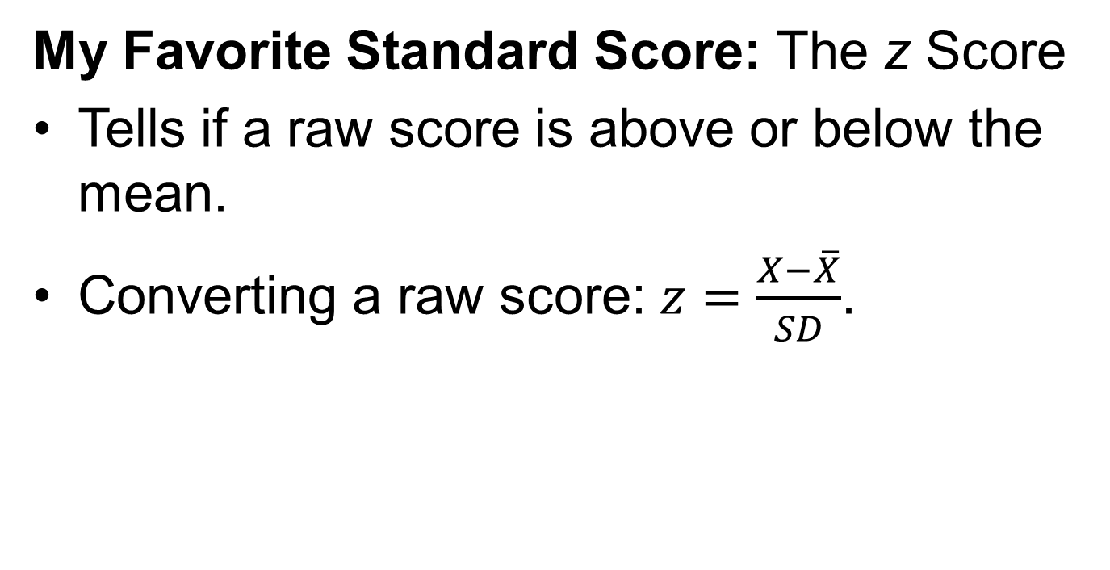
The Standard (Fare) Scores
(2 of 7)
My Favorite Standard Score: The z Score
Tells if a raw score is above or below the mean.
Converting a raw score: $z=\frac{X−\overline{X}}{SD}$.
Notes:
5.4. Calculate and interpret Z scores.
Our Favorite Standard Score: The z Score
z score:
It tells whether a raw score is above or below the mean and how far above or below the mean it is.
It is the most frequently used standard score.
Like other standard scores, it allows the comparison of scores across different distributions.
Converting a raw score to z score:
To transform a raw score into a z score, subtract the mean from the raw score and then divide that difference by the standard deviation of the set of scores.
The formula used is $z=\frac{X−\overline{X}}{SD},$where z = the z score, X = the raw score, X= the mean of the set of test scores and SD = the standard deviation of the set of test scores.
For example, let us assume that Stu has a raw score of 18.
If the standard deviation for the set of test scores is 5 and the mean is 13, then the above formula can be applied to calculate the z score which is now 1.

Slide 16
The Standard (Fare) Scores
(3 of 7)
Key observations about z score.
  Positive and negative z scores.
  Z score and standard deviation.
  Comparability across distributions.
Notes:
Positive and negative z scores:
As mentioned earlier, scores below the mean are negative z scores and those above the mean are positive z scores.
Positive z scores always fall to the right of the mean (on the normal curve) and are in the upper half of the distribution of all the scores.
Negative z scores always fall to the left of the mean and are in the lower half of the distribution.
Z score and standard deviation:
When a score is located one standard deviation above the mean, it means that the z score is 1.
For convenience while comparing test scores across distributions, z scores and standard deviations are considered equivalent.
Comparability across distributions:
Z scores across different distributions are comparable.
This means that a z score of 1 will always represent the same relative position in a set of scores, irrespective of the value of mean, standard deviation and raw score used.
This quality of z scores (easily comparable across different settings and situations) makes them useful and handy.

Slide 17
The Standard (Fare) Scores
(4 of 7)
What’s to love about z scores
What’s not to love about z scores.
Connecting z scores and percentile ranks.
Notes:
What’s to love about z scores:
Z scores are easy to compute and to understand.
They tend to range from -3 to +3 (because the normal curve has about 6 standard deviations under it) and its mean is 0.0.
z scores convey exactly where a test score lies and what its relative relationship is to the entire set of scores.
What’s not to love about z scores:
Z scores may not be easy for naive parties, such as parents, students, and non-testing professionals, to understand.
They carry the connotation of poor performance.
Like with any score with a decimal point, it is difficult to interpret the decimal component of the score on a test.
Connecting z scores and percentile ranks:
Z scores as well as percentile ranks are often used to express a test score position relative to the other test scores in a group.
To understand how z scores and percentile marks relate to each other, consider a z score of 0.
This score would correspond to a raw score equivalent to the mean of the set of scores and to a percentile of 50%, also known as the median.

Slide 18
The Standard (Fare) Scores
(5 of 7)
Normalized Standard Scores
The z scores are forced into a normal distribution.
Difference between normalized standard score and z score.
Notes:
Normalized standard score:
A norm-referenced score.
The one where the z scores are forced into a distribution that has all the characteristics of a normal curve.
Difference between normalized standard score and z score:
The normalized standard score is about the same as a standard z score.
However, the distribution of the normalized scores looks like a pretty bell-shaped curve but that of the z scores usually looks different especially with small groups and limited score ranges..

Slide 19
The Standard (Fare) Scores
(6 of 7)
Resolving the disadvantage of z scores.
Calculating the T score: T = 50 + 10z.
Notes:
Resolving the disadvantage of z scores:
One of the outstanding disadvantages of z scores is the less-than-outstanding perception of any negative score.
To address this issue, one may use a standard type of score that will never be negative, and therefore T scores ( a variant of the z scores) were introduced.
Calculating the T score:
T score: It is a standard score and is the only one that uses z scores as follows: T = 50 + 10z where T = T score and z = z score.
For example, if Stu’s raw score is 18, the corresponding z score would be 1 and this is equal to a T score of 60 (50+10).
The T score eliminates any negative numbers and fractional scores.
For example, if another individual has a raw score of 5 and a corresponding z score of -1.60, then the corresponding T score is 34 which is positive number.
Comparing z and T scores:
z scores and T scores are similar in that they are both transformed scores, and both are comparable across different distributions.
A set of z scores generated from a distribution of raw scores has a mean of 0 and a standard deviation of 1.
A set of T scores generated from the same distribution has a mean of 50 and a standard deviation of 10.

Slide 20
The Standard (Fare) Scores
(7 of 7)
Criterion-Referenced Tests
Using predefined performance levels for evaluation.
Factors that make a good candidate for criterion-based evaluation.
Importance of criterion-based test model.
Notes:
Using predefined performance levels for evaluation:
The alternative to norm-referenced, norm-based, normalized, and so-on-based tests is the criterion-based test.
It is a test where there is a predefined level of performance used to evaluate outcomes, and it has nothing to do with relative ranking among test-takers.
For example: if a score of 75 correct is defined as the level at which one gets their driver’s license, then that is the criterion in that criterion-referenced system.
Factors that make a good candidate for criterion-based evaluation:
Any kind of score that takes into account absolute performance within a particular and well-specified topic area or domain is a good candidate.
The key here is the absolute nature of the outcomes that do not make any sense when compared with the same outcome from other members of the group.
Importance of criterion-based test model:
The criterion-based test model is important because it is expected of people to be able to do thousands of things that must be based on an absolute scale of success.
For instance, a new nurse is expected to start an intravenous line with a 100% level of success and not just better than his or her classmates.

Slide 21
Your Tests and Measurements Statistics Toolkit
The Standard Error of Measurement:
  Quantifies the variation in test scores.
  Standard deviation of repeated test scores.
What the SEM Means.
Notes:
Quantifies the variation in test scores:
The standard error of measurement (or SEM) is a simple way to quantify how much a test score varies for an individual from time to time and from test to test.
It estimates the distance between observed scores and true scores and gives an estimate of the accuracy of any one test score.
In theory, it is the amount of spread that each observed score differs from each true score.
SEM: Standard deviation of repeated test scores:
An alternative way to think about SEM is that it is the standard deviation of repeated test scores.
Since one cannot be made to take a test infinite number of times, a handy formula is used to estimate the SEM.
This is done through using the standard deviation of the original set of scores and the reliability coefficient, which was already computed when the test was developed.
The formula is $SEM=SD\sqrt{1−r}$, where SEM = the standard error of measurement, SD = the standard deviation for the set of test scores, and r = the reliability coefficient of the test.
What the SEM Means:
Assume that Stu got a score of 18 and the SEM for the test is 1.80.
This can be interpreted to mean that the chances of Stu’s true score falling within 18 +/− 1.80 is about 68%.
This can be said because in the normal curve, 68% of all scores are contained within plus or minus one standard unit from the mean.
But the standard unit this time is SEM.

Slide 22
Measures of Average and Variability (1 of 6)
Purpose of averages and measures of variability.
Average: best score to represent a group.
The three different flavors of averages.
Notes:
Purpose of averages and measures of variability:
When there is lots of data, there is the need to organize and represent them in some way.
Averages and measures of variability allow such organization.
Average:
It is the one value that best represents an entire group of scores.
For instance, the batting percentages of each of the New York Yankees and other many other such groups of data can be summarized using an average.
The three different flavors of averages:
Averages are also called measures of central tendency.
It comes in three flavors: the mean, the median, and the mode.

Slide 23
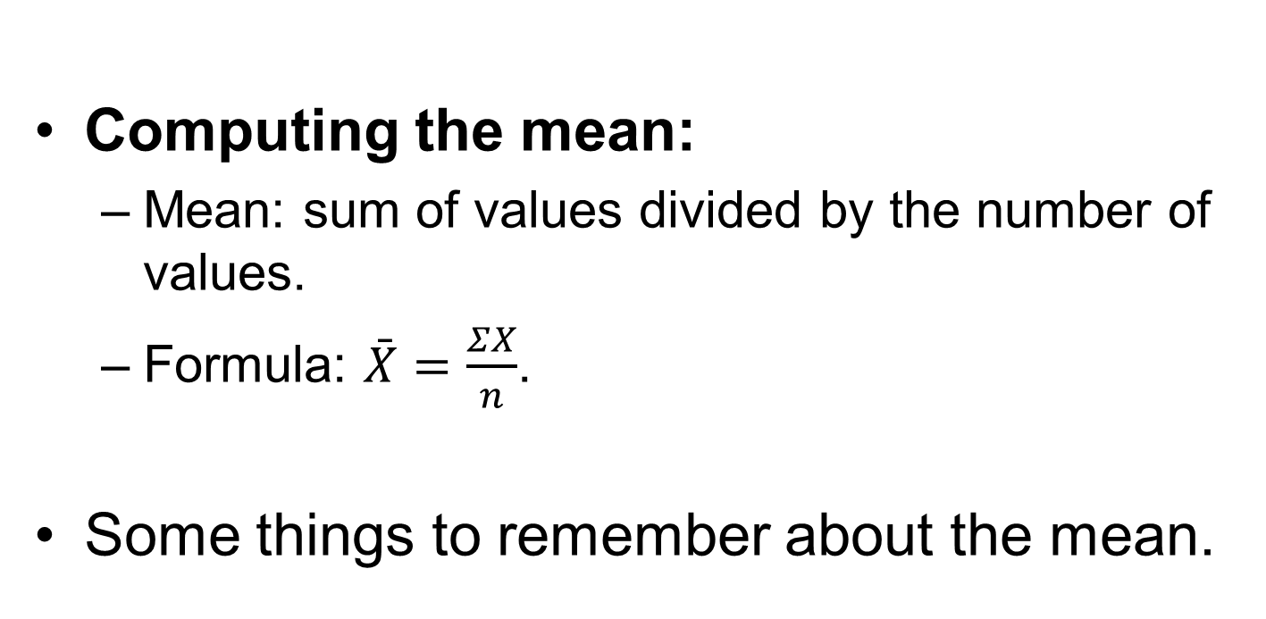
Measures of Average and Variability (2 of 6)
Computing the mean:
  Mean: sum of values divided by the number of values.
  Formula: $\bar{X}=\frac{ΣX}{n}$.
Some things to remember about the mean.
Notes:
Mean:
Mean is the most common type of average.
It is the sum of all the values in a group, divided by the number of values in that group
Formula for calculating mean:
To calculate the mean, use the following formula $\bar{X}=\frac{ΣX}{n}$.
In the formula, $\bar{X}$ (called “X bar”) = the mean value of the group of scores or the mean, ∑= the summation sign, which tells you to add together whatever follows it, X = each individual score in the group of scores, and n = the size of the sample from which you are computing the mean
Steps to calculate the mean:
List the entire set of values. (Or enter them into a computer).
Compute the sum or total of all the values.
Divide the total or sum by the number of values.
Some Things to Remember about the Mean:
The mean is sometimes represented by the letter M and is also called the typical, average, or most central score.
It reflects the population mean with most accuracy.
It is the center-most point, where all the values on one side of the mean are equal in weight to all the values on the other side of the mean.
Mean is very sensitive to extreme scores. An extreme score can make the mean less representative of the set of scores and thus less useful.

Slide 24
Measures of Average and Variability (3 of 6)
Computing the Mode:
  Mode: the value that occurs frequently.
Notes:
Mode:
Mode is the most general and least precise measure of central tendency.
It is the value that occurs most frequently, and there is no formula for computing it.
Steps to compute the mode:
To commute the mode, first list all the values in a distribution and list each only once.
Then, tally the number of times each value occurs.
The value that occurs most often is the mode.

Slide 25
Measures of Average and Variability (4 of 6)
Understanding variability:
  Variability: reflects how scores differ from one another.
  Comparing scores to the mean.
  Using variability and average together.
  The two common measures of variability.
Notes:
Variability:
It reflects how scores differ from one another.
For example: Compare three different sets of scores : 98, 86, 84, 88, 94 and 92, 89, 91, 90, 88 and 90, 90, 90, 90, 90.
All three sets have the same mean (which is 90), but the second set has more variability than the first and the third set has no variability at all.
Comparing scores to the mean:
A very accurate way of think of variability (which is also called spread or dispersion) as how different scores are from one score.
And this score that could be used as a comparison is the mean.
So now variability becomes a measure of how much each score in a group of scores differs from the mean.
Using variability and average together:
It is already known that an average is a representative score in a set of scores and variability reflects how different scores are from one another.
Together, these two can be used to describe the characteristics of a distribution and to show how distributions differ from one another.
The two common measures of variability: The variance and its square root, the standard deviation, are the most commonly used measures of variability.

Slide 26
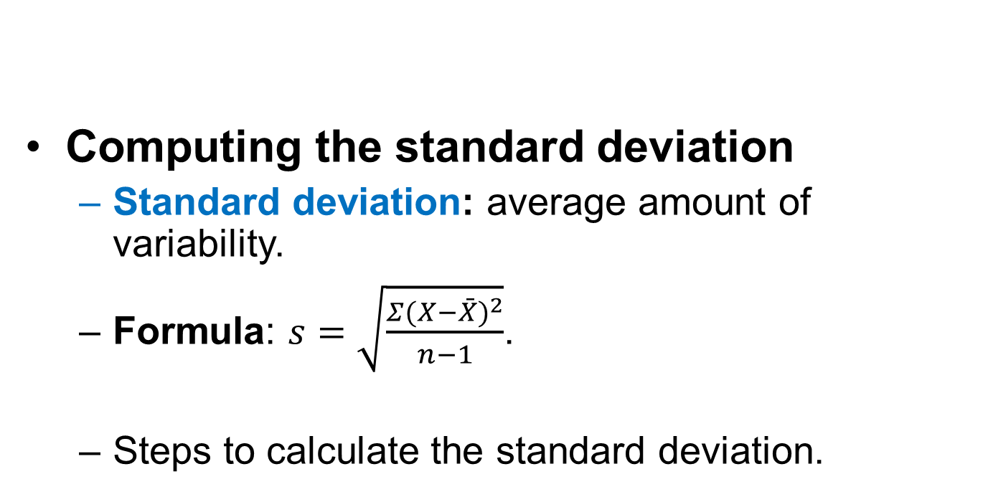
Measures of Average and Variability (5 of 6)
Computing the standard deviation
  Standard deviation: average amount of variability.
  Formula: $s=\sqrt{\frac{Σ(X−\bar{X})^{2}}{n−1}}$.
  Steps to calculate the standard deviation.
Notes:
Standard deviation:
It represents the average amount of variability in a set of scores or represents the average amount of variability in a set of scores.
Larger the standard deviation, represents the average amount of variability in a set of scores.
Formula for computing standard deviation:
The formula for computing the standard deviation is as follows.
$s=\sqrt{\frac{Σ(X−\bar{X})^{2}}{n−1}}$ where s = the standard deviation, ∑ = the sum of what follows, $(\bar{X}$) = the mean of all the scores, and n = the sample size.
The square root value is divided by n-1 instead of n or any other value for statistical reasons (so that sample data will match population data well).
Steps to calculate the standard deviation:
List each score in no particular order.
Compute the mean of the group.
Subtract the mean from each score and square each individual difference ($X−\bar{X}$).
Sum all the squared deviations about the mean and divide the sum by n − 1.
Compute the square root of the result and that is the standard deviation.

Slide 27
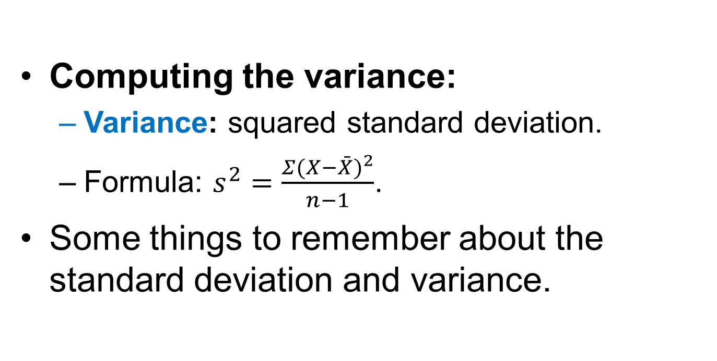
Measures of Average and Variability (6 of 6)
Computing the variance:
  Variance: squared standard deviation.
  Formula: $s^{2}=\frac{Σ(X−\bar{X})^{2}}{n−1}$.
Some things to remember about the standard deviation and variance.
Notes:
Computing the Variance:
Squared standard deviation:
The second measure of variability is the variance, which is the standard deviation squared.
So, if one knows the standard deviation of a set of scores, then simply square the number to compute the variance.
Formula for computing variance:
$s^{2}=\frac{Σ(X−\bar{X})^{2}}{n−1}$ is the formula used to compute variance.
The standard deviation without completing the last step (taking the square root), gives the variance.
Some Things to Remember about the Standard Deviation and Variance:
To calculate standard deviation, one must calculate the mean first. This is because standard deviation is computed as the average distance from the mean.
The larger the standard deviation, the more spread out the values are, and the more different they are from one another.
If the standard deviation = 0, there is absolutely no variability in the set of scores, and they are identical in value and this will rarely happen.

Slide 28
The Normal Curve (or the Bell-Shaped Curve) (1 of 5)
Visual representation of a distribution of scores with three specific features.
Justifying the use of the term “normal.”
Interpreting the curve.
Three things to note about the normal curve.
Notes:
Normal curve:
The normal curve is also called a bell-shaped curve, or bell curve.
It is the visual representation of a distribution of scores with three specific characteristics.
Justifying the use of the term “normal”:
The term normal is used because almost anything in the natural world when measured gives out scores that can vary.
When these scores are plotted as a graph, the result is a normal curve.
This is particularly true when measured at the interval level.
Interpreting the curve:
Scores from a test are marked along the X-axis with scores from the bottom starting from lowest to highest.
The Y-axis carries the percentage scores from lowest to highest.
The highest point on the curve, in the middle, means that more people got middle scores than very high or low scores.
However, it turns out that there are no extreme scores.
Three things to note about the normal curve:
When the media and mean are different, a distribution becomes skewed in one direction and the normal curve is not skewed.
Therefore, the highest point on the curve, in the middle, means that more people got middle scores than very high or low scores.
The normal curve is perfectly symmetrical about the mean.
The tails of the normal curve are asymptotic which means that they come closer and closer to the horizontal axis but never touch.

Slide 29
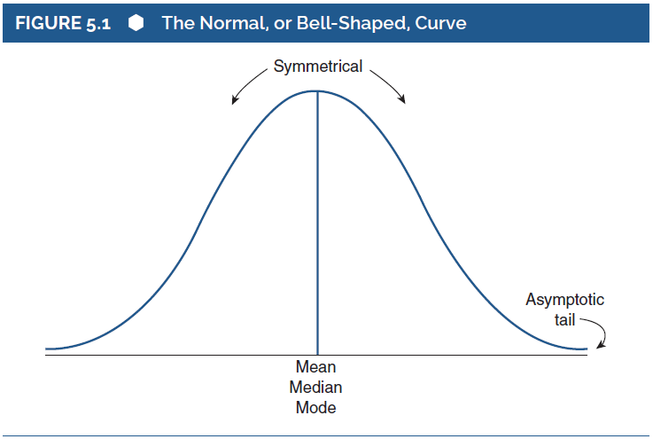
The Normal Curve (or the Bell-Shaped Curve) (2 of 5)
Notes:
5.8. Identify the proportion of scores that fall within different areas of the normal curve.
Figure 5.1: The Normal, or Bell-Shaped, Curve.

Slide 30
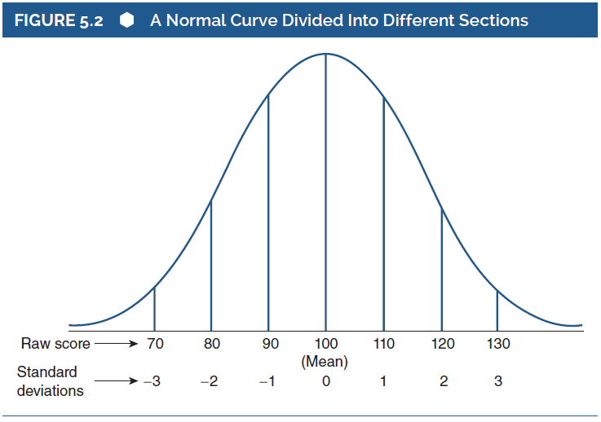
The Normal Curve (or the Bell-Shaped Curve) (3 of 5)
Notes:
The curve in the above figure represents a distribution with a mean of 100 and a standard deviation of 10.
Numbers along the x-axis (which represents the distance in standard deviations from the mean for this distribution) represents the scores in the distribution.
The scores are marked from 70 through 130 in increments of 10.
By reviewing the curve, we can state that this distribution has a mean of 100 and a standard deviation of 10.
Each vertical line within the curve separates the curve into a section, and each section is bound by particular scores.
And below each raw score (70, 80, 90, 100, 110, 120, and 130), one can find a corresponding standard deviation (–3, –2, –1, 0, +1, +2, and +3).
When the argument is further extended, it can be noticed how the range of scores represented by a normal distribution with a mean of 100 and a standard deviation of 10 is 70 through 130.
For a normal distribution like the one in the above figure, two important facts can be stated.
First, for any distribution if the scores are distributed normally (irrespective of the mean and standard deviation values), almost 100% of the scores will fit between −3 and +3 standard deviations from the mean. This is very important, because it applies to all normal distributions. This makes it possible for distributions to be compared with one another.
Second, if the distribution of scores is normal, it can be stated that between different points along the x-axis (such as between the mean and 1 standard deviation), a certain percentage of cases will fall.

Slide 31
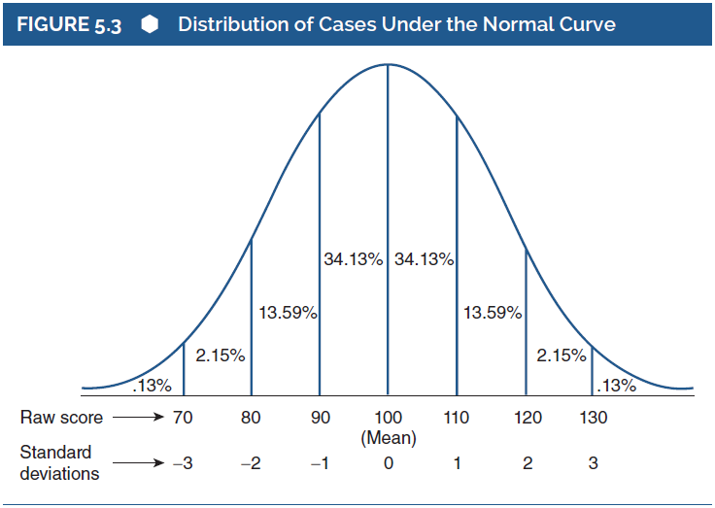
The Normal Curve (or the Bell-Shaped Curve) (4 of 5)
Notes:
5.8. Identify the proportion of scores that fall within different areas of the normal curve.
Figure 5.3: Distribution of Cases Under the Normal Curve.
More Normal Curve 101
The above figure represents a normal curve with mean equal to 100 and the standard deviation equal to10.
It can be concluded that (if the mean = 100 and the standard deviation = 10) :
The distance between the mean and 1 standard deviation includes 34.13% of all the cases under the curve and the scores that are included are from 100 to 110.
The distance between 1 and 2 standard deviations includes 13.59% of all the cases under the curve and the scores that are included are from 110 to 120.
The distance between the 2 and 3 standard deviations includes 2.15% of all the cases under the curve and the scores that are included are from 120 to 130.
The distance between 3 standard deviations beyond and above includes 0.13% of all the cases under the curve and the scores that are included are above 130.
When all the values from either half of the normal curve are added, the answer obtained is 50%.
And this is because the distance between the mean and all the scores to the right of the mean underneath the normal curve includes 50% of all the scores.
Since the curve is symmetrical about its central axis, the two halves together represent 100% of all the scores.
The same logic can be applied to the left of the mean of 100 too and the following inferences can be drawn (again if the mean = 100 and the standard deviation = 10).
The distance between the mean and -1 standard deviation includes 34.13% of all the cases under the curve and the scores that are included are from 90 to 100.
The distance between -1 and -2 standard deviations includes 13.59% of all the cases under the curve and the scores that are included are from 80 to 90.
The distance between the -2 and -3 standard deviations includes 2.15% of all the cases under the curve and the scores that are included are from 70 to 80.
The distance between -3 standard deviations beyond and below includes 0.13% of all the cases under the curve and the scores that are included are below 70.

Slide 32
The Normal Curve (or the Bell-Shaped Curve) (5 of 5)
More Normal Curve 101
Scores that do not fall between the raw score of 90 and 110.
Reason the curve is not skewed.
Probabilities of occurring is associated with specific scores.
Notes:
Scores that do not fall between the raw score of 90 and 110:
Not all distributions have a mean of 100 and a standard deviation of 10.
In our example, (roughly) 68% (34.13% doubled) of the scores fall between the raw score values of 90 and 110.
But of the remaining 32%, one half falls above (to the right of) 1 standard deviation above the mean, and the other half falls below (to the left of) 1 standard deviation below the mean.
Reason the curve is not skewed:
As the curve slopes and the amount of area decreases as one moves farther away from the mean, the likelihood that a score will fall more toward the extremes of the distribution is less than the likelihood that it will fall toward the middle.
This is the reason the curve has a bump in the middle and is not skewed in either direction.
Probabilities of occurring is associated with specific scores:
In any set of test scores that is normally distributed, it can be assumed that there are probabilities of occurring associated with specific scores.
These probabilities can be used as benchmarks to understand how likely (or unlikely) it is that a particular outcome will occur.
The same logic is applied to inferential statistics too.

Slide 33
It’s All Relative Correlations (1 of 3)
Learning the relationship between variables.
Calculation of reliability and validity coefficients.
Correlation coefficient: numerical index to represent relationship between variables.
Notes:
Learning the relationship between variables:
Central tendency and variability are critical in describing the characteristics of a distribution.
An equally interesting thing is the relationship between variables (how the value of one variable changes when the value of another variable changes).
This interest is expressed through the computation of a simple correlation coefficient.
Calculation of reliability and validity coefficients:
Correlation coefficient is important in the calculation of reliability coefficients of all sorts.
Also, validity coefficients are almost always expressed as correlations.
Correlation coefficient:
It is a numerical index that reflects the relationship between two variables.
Its value ranges between –1 and +1.
A correlation between two variables is sometimes referred to as a bivariate (for two variables) correlation, and it is technically called the Pearson product-moment correlation.

Slide 34
It’s All Relative Correlations (2 of 3)
Types of correlation coefficients.
  Positive and negative correlations.
  Types of correlations and the corresponding relationship between variables.
Things to remember about correlations.
Notes:
Positive and negative correlations:
If variables change in the same direction, the correlation is called a direct correlation or a positive correlation.
If variables change in opposite directions, the correlation is called an indirect correlation or a negative correlation.
Types of correlations and the corresponding relationship between variables:
When variable x increases in value, variable y decreases in value, the type of correlation is direct or positive (00 to +1.00). Example: The more time you spend studying, the higher your test score will be.
When variable x decreases in value, variable y decreases in value, the type of correlation is direct or positive (00 to +1.00).Example:The less money you put in the bank, the less interest you will earn.
When variable x increases in value, variable y increases in value, the type of correlation is direct or negative (−1.00 to .00). Example: The more you exercise, the less you will weigh.
When variable x decreases in value, variable y increases in value, the type of correlation is direct or negative (00 to +1.00). Example: The less time you take to complete a test, the fewer you’ll get right.
Things to Remember about Correlations:
A correlation can range in value from –1 to +1.
The absolute value of the coefficient reflects the strength of the correlation, and this means a correlation of −.70 is stronger than a correlation of +.50.
A correlation always reflects the situation where there are at least two data points (or variables) per case.
It is easy to make the mistake of assigning a value judgment to the sign of the correlation. That’s why, instead of using the terms negative and positive, the terms indirect and direct communicate a clearer meaning.

Slide 35
It’s All Relative Correlations (3 of 3)
Bunches of correlations: the correlation matrix.
  Working with three variables.
  Interpreting the strength of correlations.
Squaring the correlation coefficient.
Notes:
Bunches of Correlations: The Correlation Matrix:
Working with three variables:
Consider that there are three measures of overall school performance: math score, participation in extra-curricular activities, and SAT scores.
In this case, a correlation matrix can be used to illustrate the correlations and in such a matrix, for each pair of variables, there will be a correlation coefficient.
In a matrix with three variables, there are always 3!/(3–2)!2!, or three things taken two at a time for a total of three correlation coefficients.
Variables correlate perfectly with themselves, and the matrix creates a mirror image of itself.
Such matrices that use correlations are used to describe the relationship between several variables.
Interpreting the strength of correlations:
Based on the size of the correlation coefficient, general interpretations can be drawn.
Value .8 to 1.0 refers to very strong relationship.
Value .6 to .8 refers to strong relationship.
Value 4 to .6 refers to moderate relationship.
Value .2 to .4 refers to weak relationship.
Value 0 to .2 refers to weak or no relationship.
The above interpretations are based on the correlations seen by measurement people everyday, with their large reliability coefficients and big correlations among similar tests.
Since psychologists and social scientists use much lesser-known variables from the real world (like personality traits), they use a different scale when putting words around the size of correlations.
A determined Effort: Squaring the Correlation Coefficient:
A more precise way to interpret the correlation coefficient: computing the coefficient of determination.
It is the percentage of variance in one variable that is accounted for by the variance in the other variable.
It is computed by squaring the correlation coefficient.
For example: if the correlation between GPA and number of hours of study time is .70, then the coefficient of determination, represented by r²_{GPA‧time}, is .7², or .49.
This implies that 49% of the variance in GPA can be explained by the variance in studying time.
However, the remaining 51% cannot be explained.
This amount of unexplained variance (1-coefficient of determination) is called the coefficient of alienation.

